Slide 1

Mapping mazon Reviews to Stars
Irene Won Choi & Khushant Khurana

Slide 2

01
Problem Statement
02
Pre-Processing
03
Contents
Model Development
04
Results
05
Hyperparameter Tuning
06
Future Work
Notes:
slidesppt.net
2

Slide 3

Problem Statement
Develop a machine learning model to classify textual reviews by predicting what the rating of a product will be.
OBJECTIVE
Stars offer a quantitative measure!
Trends of given stars over time can be used for marketing because of their anonymous nature.
WHY?
Notes:
3

Slide 4
PART
1
INTRO
Acquiring the dataset!
Raw Data Exploration

Slide 5

Approach
Source
Kaggle: “Sentiment Analysis Python” by Rob Mulla
Structure
Features inclide product ID, Score, Text Review and small summary for the text review.
Size
The dataset contains 568454 reviews.
Distribution
The dataset contains a lot more text reviews with 5 stars.

Slide 6
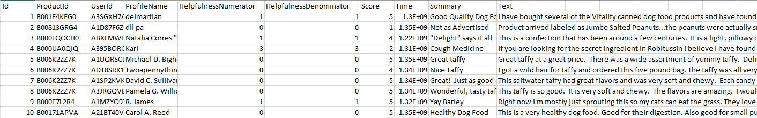
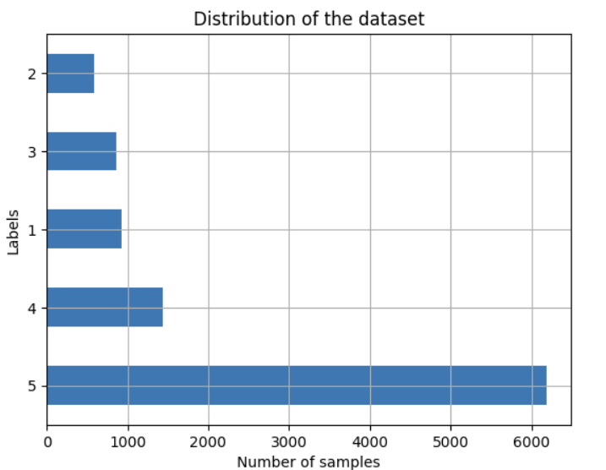
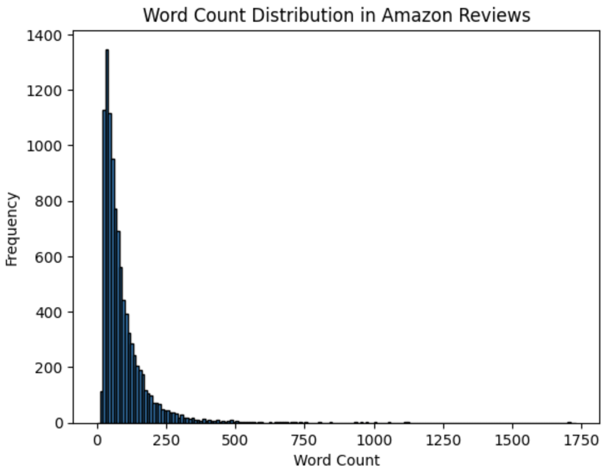
Dataset
Raw dataset

Slide 7
PART
2
Preprocessing
Tokenization
Preparing Data for the Model

Slide 8

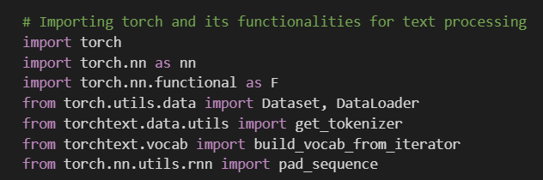
Framework used
Importing torch and its extensions.
Notes:
slidesppt.net
8

Slide 9
Methodology For Pre-Processing
Tokenization
Convert tokenized text to tensor
Implement size consistency for all tensors
Create batches

Slide 10
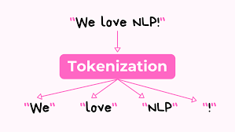
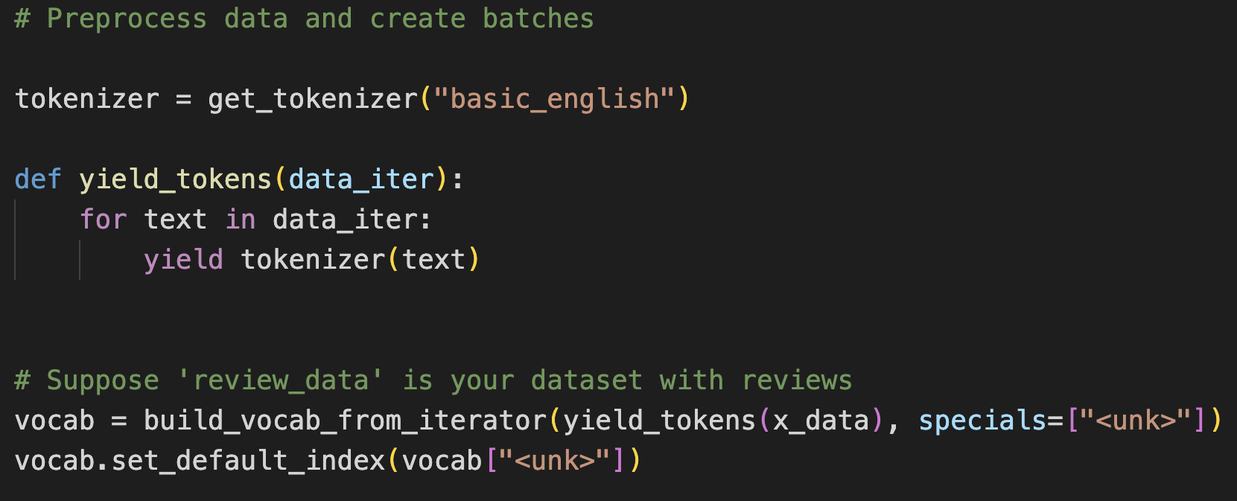
Tokenization
PyTorch Tokenizer!
Convert text to tokens
Building vocab object!
Notes:
s the process of converting text into smaller units, called tokens. These tokens can be words, characters, or subwords. IT’s a fundamental step in text processing and analysis, as it prepares the raw text for various NLP tasks like language modeling, sentiment analysis, text classification, and machine translation.
Tokenizatoin:

Slide 11
Methodology For Pre-Processing
Tokenization
Convert tokenized text to tensor
Implement size consistency for all tensors
Create batches

Slide 12
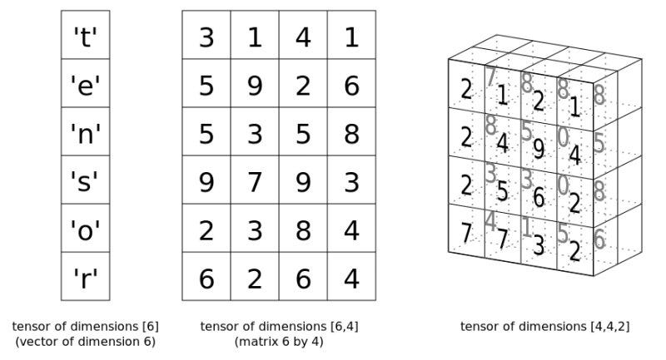
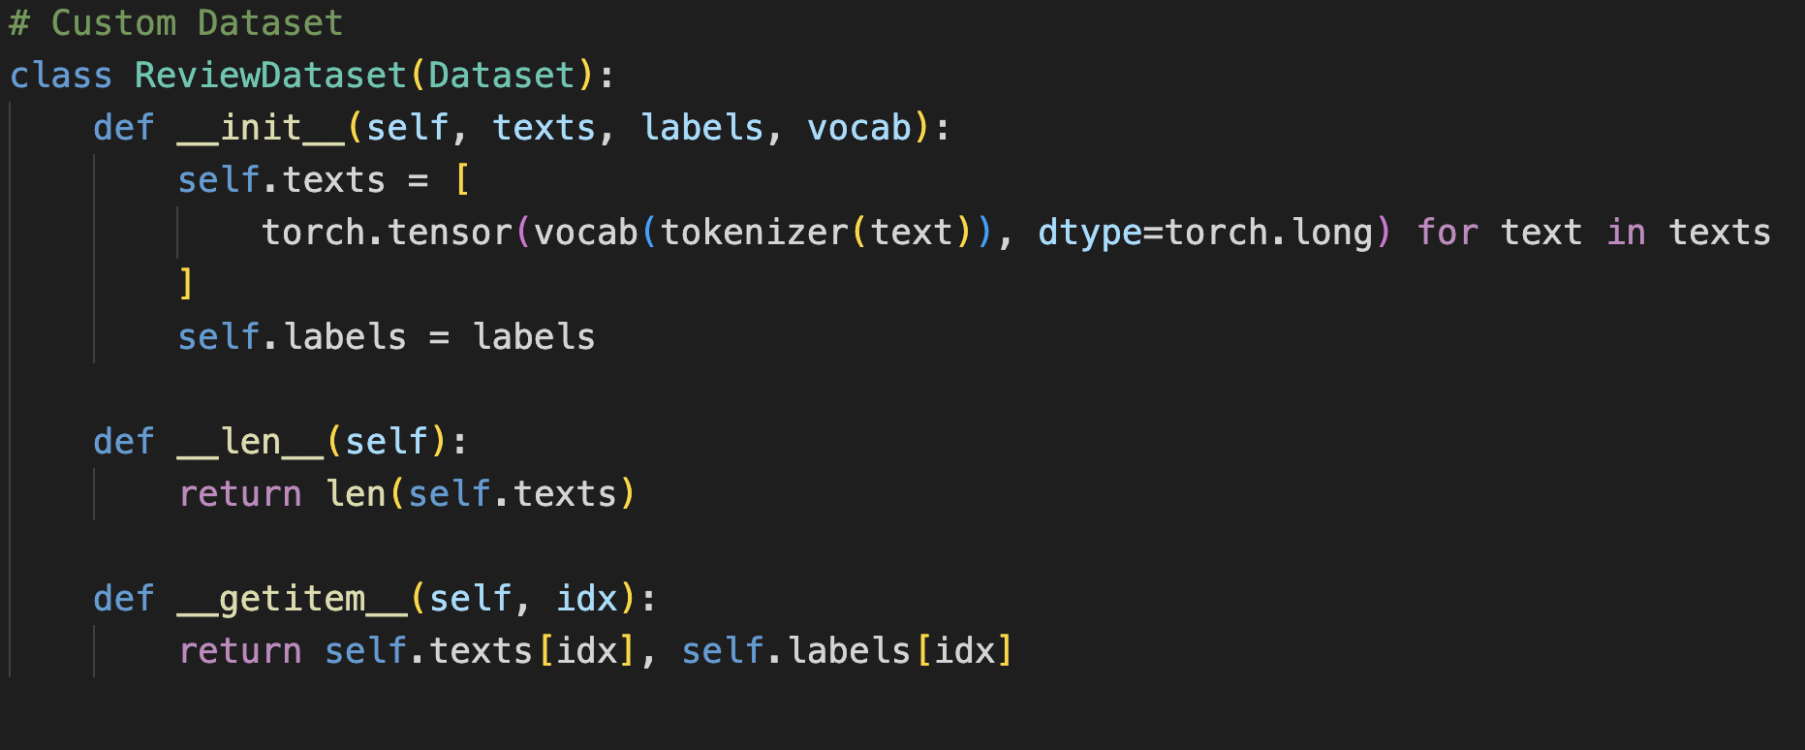
Converting tokenized text to tensors
Function to tokenize text and convert to “long” datatype tensor.
Notes:
Tokenized Text to tensors -> tensors are basically matrices.

Slide 13
Methodology For Pre-Processing
Tokenization
Convert tokenized text to tensor
Implement size consistency for all tensors
Create batches

Slide 14
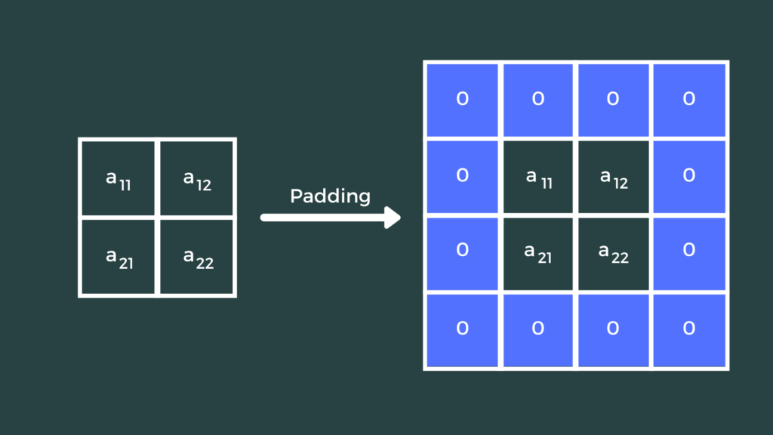
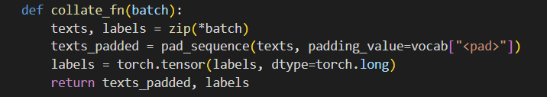
Implementing size consistency for tensors
Notes:
Collate function pads the tensors so that the tensors have the same size. This is an important process because if the tensors are different sizes, it will become problematic during the training process.

Slide 15
Methodology For Pre-Processing
Tokenization
Convert tokenized text to tensor
Implement size consistency for all tensors
Create batches

Slide 16
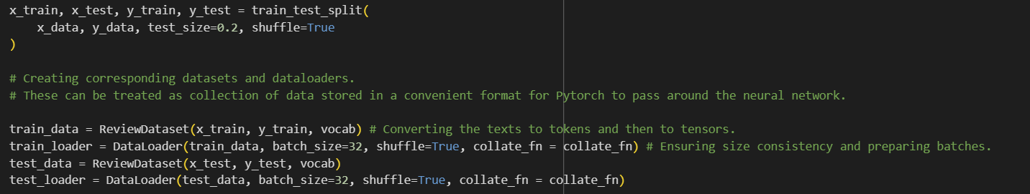
Creating batches

Slide 17
PART
3
Model Development
Creating Neural Network Model
Defining training and validating functions
Training and testing the model!

Slide 18
Neural Networks
We used Neural Networks, which are a type of model inspired by human brain functioning to analyze the sentiment of Amazon reviews.
Embedding Layer: model that translates numbers (representing words) into vectors that capture the meaning of words.
Fonts, font sizes, colors, leadings, and so on can be modified in the Start panel at the top.
Notes:
slidesppt.net
18

Slide 19
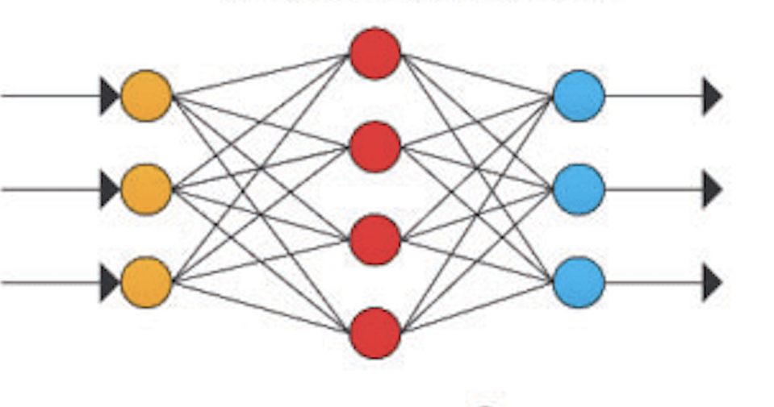
EMBEDDING LAYER
Linear layer
INPUT REVIEW
Categories
Notes:
slidesppt.net
19

Slide 20
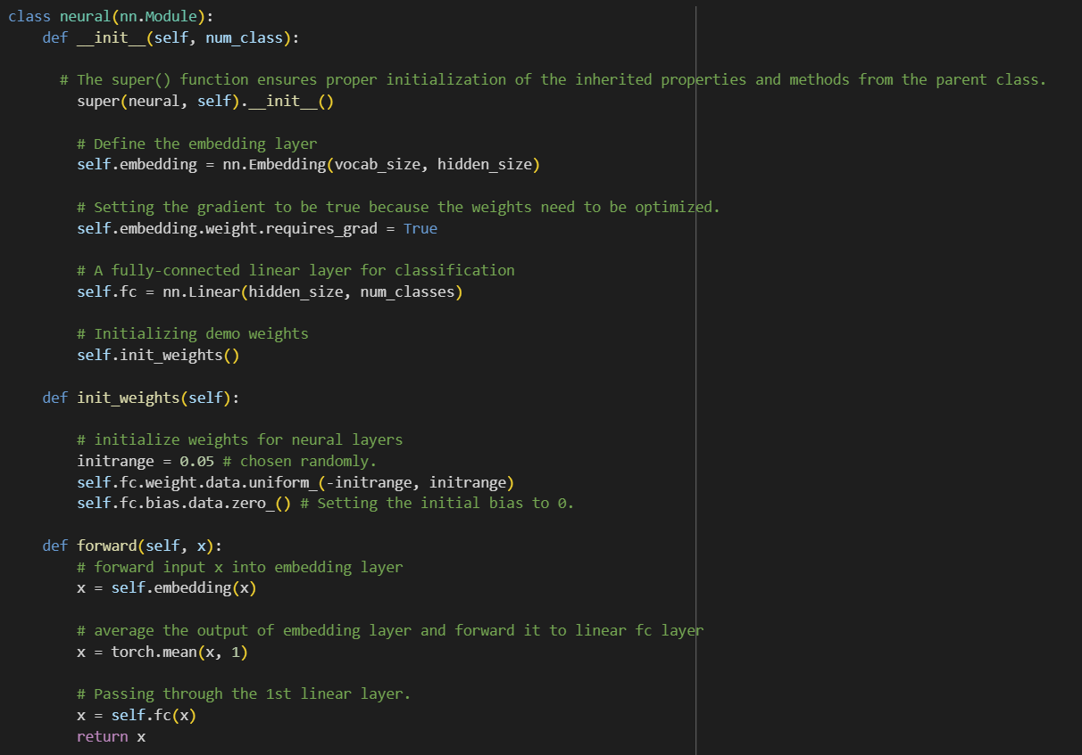
Creating the neural network
Defining embedding layer
Setting gradient calculation to TRUE
Defining linear layer
Defining the hierarchy of the neural net

Slide 21
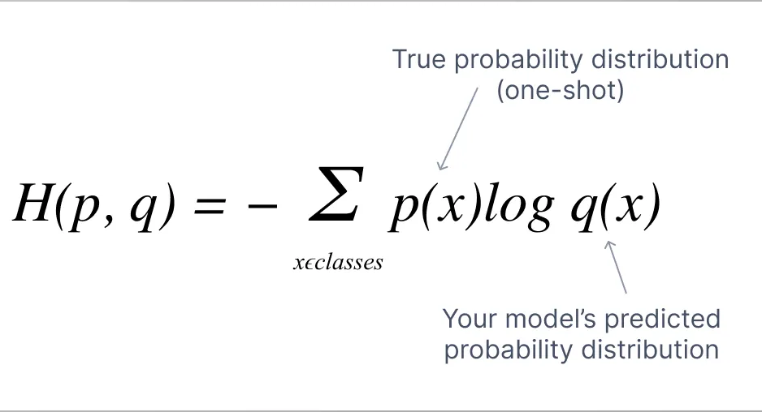
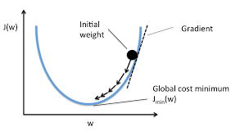

Initiating models and other features
Cross entropy Loss
Stochastic Gradient Descent
Hyper-parameter

Slide 22
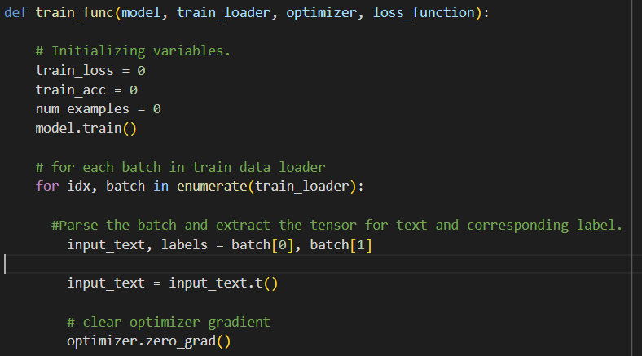
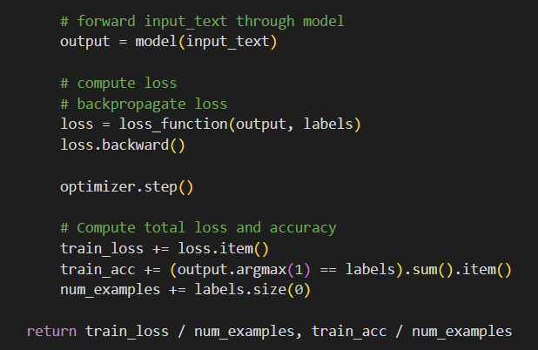
Clear optimizer gradient
Forward the batch to the model.
Compute loss.
Back propagate loss
Return accuracy.
Training and validating models

Slide 23
PART
4
RESULTS
Training and Testing Accuracy scores.

Slide 24
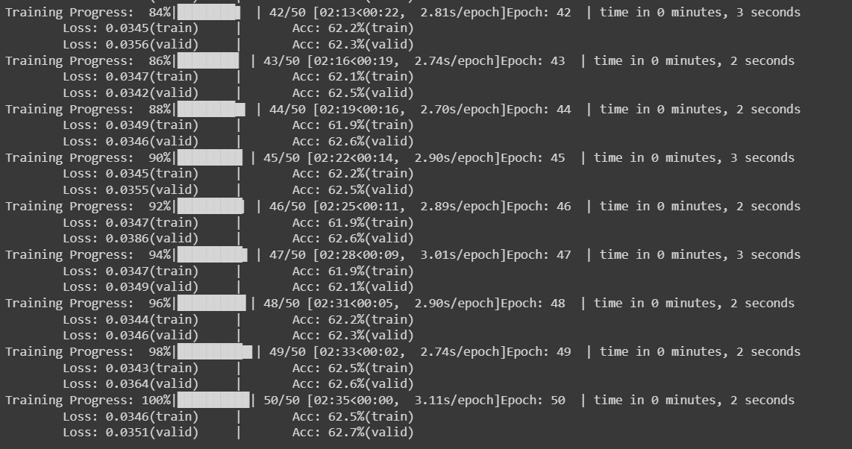
The accuracy seems to cap off around 63 percent.

Slide 25
PART
5
Hyperparameter tuning.
Evolving the neural net to deep neural net.
Varying learning rate.
Varying number of epochs.
Varying batch size.

Slide 26
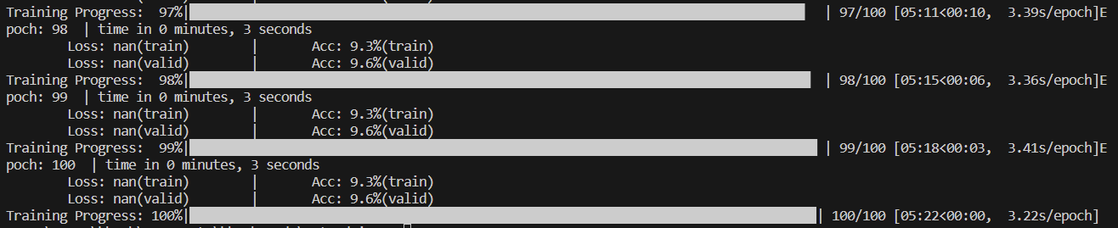
Evolving the net to a deep net!
Deep nets are extremely bad. The resulting accuracy is less than 10%.

Slide 27
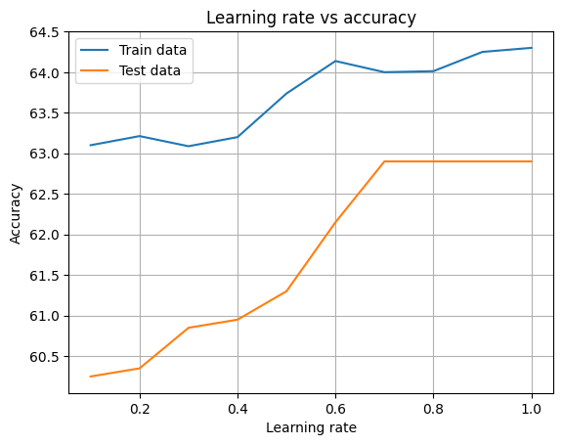
Iterating over learning rate
The best learning rate is around 0.8. After that the validation accuracy becomes constant.

Slide 28
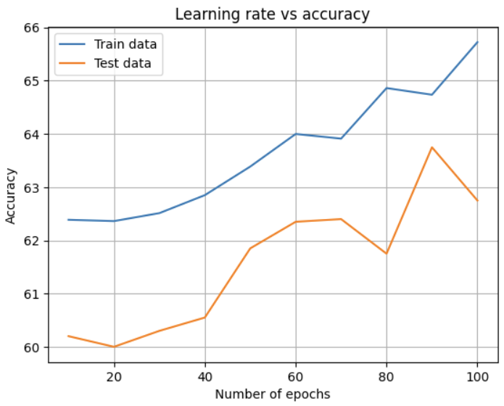
Iterating over number of epochs
It seems like that the accuracy keeps increasing with the number of epochs. Lets test that!

Slide 29
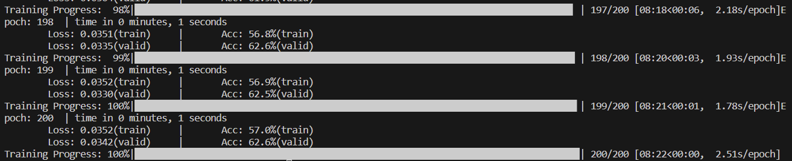
Trying number of epochs = 200
So the accuracy does not keep rising with number of epochs. Accordingly, there must be a cutoff. Regardless, the accuracy is around 65 percent. But it could be said that the best accuracy comes around epoch size to be 100.

Slide 30
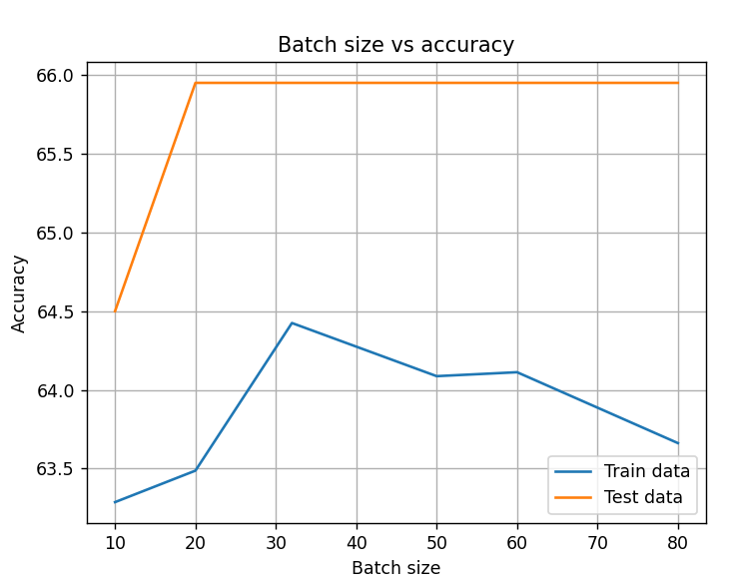
Iterating over batch size
It seems that batch size of 32 has the highest accuracy.

Slide 31
PART
6
Future Work
Possible steps to increase model accuracy.

Slide 32

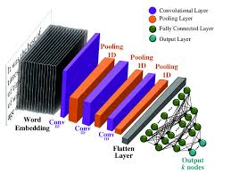
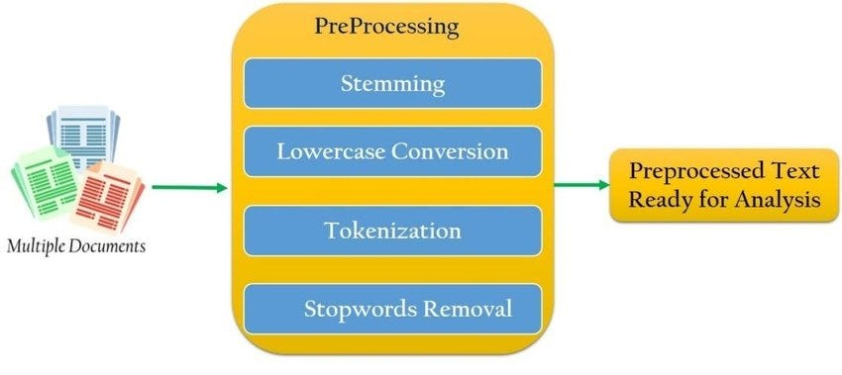
Future Work
Pre-trained word embeddings
Convolutional neural network
Better pre-processing for text data.
Notes:
slidesppt.net
32

